Slide 1
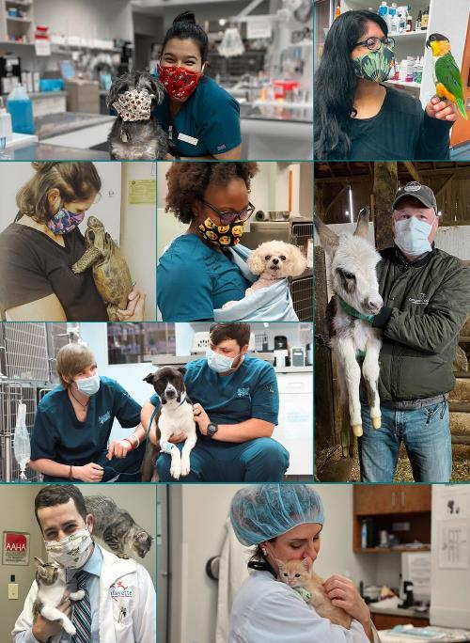
Monthly Marketing Planner
October 2021
General Practices

Slide 2
Monthly Marketing Planner
October – General Practices
Welcome to the October Monthly Marketing Planner! This month's topics include dentistry visits, Online Booking Tool, and national campaigns such as National Veterinary Technician Week. We also provide posts for National Pet Wellness Month, Animal Welfare Week, home delivery, PAW Plans, Halloween and more!
National Campaigns
Revenue and Visit Drivers
Client Engagement
National Pet Wellness Month
National Walk Your Dog Week
Animal Welfare Week
National Veterinary Technician Week
National Pet Obesity Awareness Day
National Feral Cat Day
Online Booking Tool
Home Delivery (Price drop!)
PAW Plans (if applicable)
Dentistry Visits/Appointments Available
Share the Love
Vet Tech Shoutouts
National Cat Day
National Fire Pup Day
Halloween Costume Contest
Halloween
Home Delivery New Low Pricing Initiative Continues!
Generic Home Delivery posts are available with optional New Low Pricing copy also included!
Tips For Social Media
DID YOU KNOW that local photos you share from your hospital generate almost 3x as many interactions than stock photography?*
For inspiration check out slide 4
Need social media support? We can post on your behalf Thursdays and Saturdays! Email marketing@nva.com to get started!
AllyDVM
Banners are preloaded into the platform. The copy can be cut and be pasted into a Mass Email Communication. Instructions how to send a Mass Email are also included.
GP Connect
NEW! DOWNLOAD HIGH RESOLUTION SOCIAL GRAPHICS FROM GP CONNECT
  https://www.gpconnect.nva.com Password: woof2020
Click on Social Media and Marketing Planner tab
  Click on the image that you wish to use, and then right-click and save!
Have questions? Contact your Marketing Business Partner!
*avg # of interactions based on organic photos from site level vs stock photography auto-posts in January 2021
Notes:
General Wellness is an ongoing theme throughout the month
Week of Jan. 4: Walk Your Pet Week theme (Jan is Walk Your Pet Month)
Week of Jan. 11: Have you Been to the Vet Recently? Theme
Week of Jan. 18: Share the Love
Week of Jan. 25: Change a Pet’s Life Week (adoption) theme (Sunday, Jan 24th is Change a Pet’s Life Day)
Auto-Post: Jan. 14th: Dress Up Your Pet Day
Auto-Post: Jan. 21: National Answer Your Cat’s Question Day (Friday, Jan 22nd is Natl Answer Your Cat’s Q Day)
Auto-Post Jan. 28: Change a Pet’s Life

Slide 3
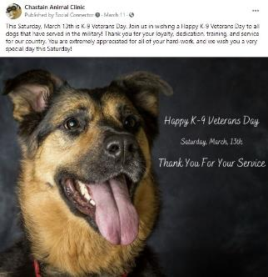

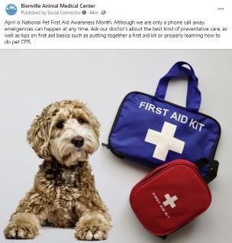
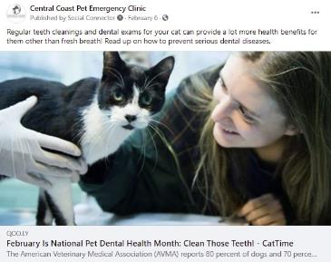
NVA Social Media Support
Opt-in to our free nva social media support! We will post on your behalf Thursdays and Saturdays! Email marketing@nva.com to get started!
NVA auto-post examples:
Pet Holidays
National Holidays
General Business-Drivers
Wellness Tips
Saturday Caturday (cat wellness)
Extra social media engagement
And More!
See why over 450 NVA General Practices love our auto-posts!
Email marketing@nva.com to learn more

Slide 4
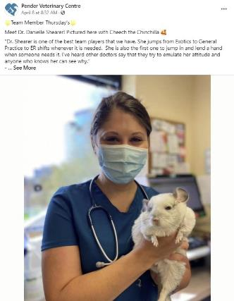
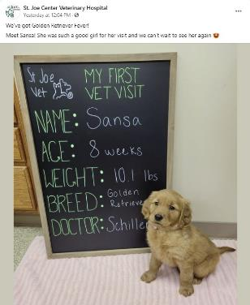
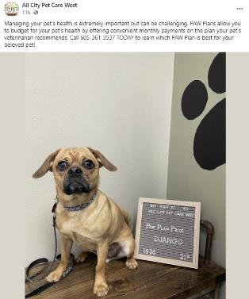
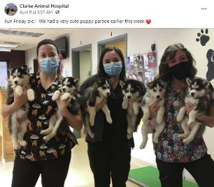
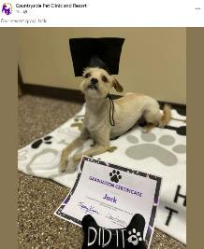
Social Media Inspiration
Local photos from your hospitals perform 3X better on social media than stock photography! Here are a few wonderful examples from around our nva community:

Slide 5





Marketing Calendar: 10/1 – 10/31
Below is a suggested marketing calendar to follow. Please adjust it to fit your hospital’s needs.
Most Important Monday | Email Tuesday | Wellness Wednesday | NVA Thursday | Fun Friday | Saturday Caturday
POST + SHARE! Pin your most important post of the week on Facebook to show up all week | SEND EMAIL Take a break on social & email important updates to your clients | POST + SHARE! Share info that’s good for your community to know | NO ACTION REQD If participating, posts will be shared on your behalf. To opt in/out, email Marketing@nva.com | POST + SHARE! Inspire, entertain, and show off who you are! | NO ACTION REQD If participating, posts will be shared on your behalf. To opt in, email Marketing@nva.com
MON 9/27 | TUE 9/28 | WED 9/29 | THU 9/30 | FRI 10/1 | Sat 10/2
World Rabies Day or Wellness Visit SOCIAL: Choose from posts here. 1) World Rabies Day (9/28) 2) National Pet Insurance Month (Wellness Visit) | Share news with your clients HOSPITAL EMAIL: Appointments Available. Click Here. OR VENDOR EMAIL: Covetrus and Vetsource | Home Delivery or PAW Plans SOCIAL: Choose from posts here: 1) Home Delivery 2) PAW Plans | Gratitude SOCIAL: NVA will post on your behalf if opted-in View scheduled post here. | Social engagement SOCIAL: Choose from posts here. 1) National Fire Pup Day 2) National Black Dog Day | Black Cat Awareness Month SOCIAL: NVA will post on your behalf if opted-in View scheduled post here.
MON 10/4 | TUE 10/5 | WED 10/6 | THU 10/7 | FRI 10/8 | Sat 10/9
World Animal Day or Animal Welfare Week SOCIAL: Choose from posts here. 1) World Animal Day 2) Animal Welfare Week | Share news with your clients HOSPITAL EMAIL: Free Email Day. Click Here. OR VENDOR EMAIL: Covetrus and Vetsource | Home Delivery or PAW Plans SOCIAL: Choose from posts here: 1) Home Delivery 2) PAW Plans | National Walk Your Dog Week SOCIAL: NVA will post on your behalf if opted-in View scheduled post here. | Social engagement SOCIAL: Choose from post here. Pet Patient of the Month National Walk Your Dog Week | Animal Welfare Week SOCIAL: NVA will post on your behalf if opted-in View scheduled post here.
MON 10/11 | TUES 10/12 | WED 10/13 | THU 10/14 | FRI 10/15 | Sat 10/16
Dentistry Visit or Online Booking Tool SOCIAL: Choose from posts here. 1) Dentistry Visit 2) Online Booking Tool | Share news with your clients HOSPITAL EMAIL: Dentistry Visit Visit. Click Here. OR VENDOR EMAIL: Covetrus and Vetsource | Home Delivery or PAW Plans SOCIAL: Choose from posts here. 1) Home Delivery (Ntl’ Pet Obesity Awareness Day) 2) PAW Plans | National Pet Wellness Month SOCIAL: NVA will post on your behalf if opted-in View scheduled post here. | Social engagement SOCIAL: Choose from post here: 1) DVM Dentistry Tip 2) National Fetch Day (10/17) | National Feral Cat Day SOCIAL: NVA will post on your behalf if opted-in View scheduled post here.

Slide 6
Marketing Calendar: 10/1 – 10/31
Below is a suggested marketing calendar to follow. Please adjust it to fit your hospital’s needs.
Most Important Monday | Email Tuesday | Wellness Wednesday | NVA Thursday | Fun Friday | Saturday Caturday
POST + SHARE! Pin your most important post of the week on Facebook to show up all week | SEND EMAIL Take a break on social & email important updates to your clients | POST + SHARE! Share info that’s good for your community to know | NO ACTION REQD If participating, posts will be shared on your behalf. To opt in/out, email Marketing@nva.com | POST + SHARE! Inspire, entertain, and show off who you are! | NO ACTION REQD If participating, posts will be shared on your behalf. To opt in, email Marketing@nva.com
MON 10/18 | TUE 10/19 | WED 10/20 | THU 10/21 | FRI 10/22 | Sat 10/23
National Veterinary Technician Week Vet Tech Shoutout or Share the Love SOCIAL: Choose from posts here. 1) Vet Tech Shoutout 2) Share the Love | Share news with your clients HOSPITAL EMAIL: Share the Love. Click Here. OR VENDOR EMAIL: Covetrus and Vetsource | Vet Tech Shoutout or PAW Plans SOCIAL: Choose from posts here: 1) Vet Tech Shoutout 2) PAW Plans | National Veterinary Technician Week SOCIAL: NVA will post on your behalf if opted-in View scheduled post here. | Social engagement SOCIAL: Choose from post here. Vet Tech Shoutout Vet Tech Dentistry Tip | National Cat Day (10/29) SOCIAL: NVA will post on your behalf if opted-in View scheduled post here.
MON 10/25 | TUE 10/26 | WED 10/27 | THU 10/28 | FRI 10/29 | Sat 10/30
Dentistry Visit or We’re Hiring SOCIAL: Choose from posts here. Dentistry Visit We’re Hiring | Share news with your clients HOSPITAL EMAIL: We’re Hiring. Click Here. OR VENDOR EMAIL: Covetrus and Vetsource | Home Delivery or PAW Plans SOCIAL: Choose from posts here: 1) Home Delivery 2) PAW Plans | Pet Halloween Costume SOCIAL: NVA will post on your behalf if opted-in View scheduled post here. | Social engagement SOCIAL: Choose from post here. National Cat Day Happy Halloween! (10/31) | Halloween Cat Safety Tips SOCIAL: NVA will post on your behalf if opted-in View scheduled post here.

Slide 7
10/1 - Fun Friday
Choose 1 post from the options below:
1. National Fire Pup Day
Post Copy:
Happy #NationalFirePupDay! Today we recognize the canine firefighters who bravely serve with local fire departments around the country. Thank you!
Post Photo:
*No post photo. Intended for your clients to share their own comments and engage with the post.
2. National Black Dog Day
Post Copy:
Today is #NationalBlackDogDay! Share a photo of your dog below in the comments so that other clients can wish them a Happy Black Dog Day!
Post Photo:
*No post photo. Intended for your clients to share their own comments and engage with the post.

Slide 8
10/2 – Saturday Caturday
FYI ONLY – THIS WILL BE POSTED ON YOUR BEHALF, IF OPTED INTO NVA CONTENT. NOT PARTICIPATING? EMAIL MARKETING@NVA.COM TO GET STARTED.
Black Cat Awareness Month
Post Copy:
Did you know that black cats are still viewed as less adoptable than other cats? For October’s #BlackCatAwarenessMonth, we’ve compiled a few reasons why we think they’d make amazing pets!
https://cattime.com/cat-facts/advocacy/39441-black-cat-awareness-month#1
Post Photo:
*Photo will populate from image link preview

Slide 9
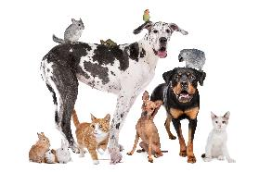
10/4 – Most Important Monday
Choose 1 post from the options below:
1. World Animal Day
Post Copy:
Promo:
Today is #WorldAnimalDay, a day to advocate for our animal counterparts to improve their welfare around the world. In honor of #WorldAnimalDay, we are happy to offer $[xx] off your pet’s next dental exam with us! Simply post a photo of your pet and tag #WorldAnimalDay to help raise awareness for all animal welfare standards across the globe. Show your photo at check-in.
Non-Promo:
Today is #WorldAnimalDay, a day to advocate for our animal counterparts to improve their welfare around the world. Share a photo of your pet and tag #WorldAnimalDay to help raise awareness for all animal welfare standards across the globe.
Post Photo:
2. Animal Welfare Week
Post Copy:
This week is Animal Welfare Week, and we would like to give a special shoutout to [Name of Local Shelter] for providing loving care to countless animals while they eagerly wait to be adopted by their new family. Visit their website and you may find that new family member that you have been searching for! [Shelter Website URL].
Post Photo:
*Photo will populate from image link preview
Download high resolution images from GP Connect
https://www.gpconnect.nva.com/
Password woof2020

Slide 10





10/5 – Email Tuesday
Free Email Day!
Use this Tuesday to email your clients on ongoing promotions, hospital updates, or news for the new month. Share any upcoming holidays, events, specials, etc. coming in October for your hospital!
If you use AllyDVM and Online Booking Tool through Vetstoria at your practice, we have uploaded OBT buttons in your dashboard image library. You can use these as Call to Action to drive visits at your practice.
*Reminder: When you utilize the OBT button as well as Social Media Icons at the bottom of your email, please hyperlink them to the Vetstoria OBT URL button in AllyDVM.

Slide 11
10/5 – Vendor Email
Click the links to see the weekly client engagement from covetrus and vetsource
For Vetsource monthly marketing materials including PetMail and Social Media Posts click here
For Covetrus monthly marketing materials click here

Slide 12
Creating a Mass Email in AllyDVM
Right-click on the document below -> Acrobat document object -> open

Slide 13



10/6 – Wellness Wednesday
Choose 1 post from the options below:
1. Home Delivery
Post Copy:
We’ve got all of your puppy needs for Adopt-A-Dog Month! Head on over to our online store to shop for all items that will make your dog feel welcomed in their new home! You may also qualify for auto-ship savings, and [new low pricing on most items!]. [Online Pharmacy Link].
Post Photos:
Covetrus Vetsource
2. PAW Plans
Post Copy:
Don’t let too many Halloween treats spoil your loved one’s dental care. Just like regular wellness visits, dental cleanings should be part of routine pet care because it can help catch or prevent conditions of the gums and bones that hold teeth in place. To find out more about your pet’s dental care, call [Hospital Phone Number] TODAY and learn which one of our PAW Plans is best for you and your loved one.ost #2
Post #2
Post Photo:
Share a photo of one of your recent PAW Plans patients! Local photos at the location level do much better than stock photography!
Download high resolution images from GP Connect
https://www.gpconnect.nva.com/
Password woof2020

Slide 14

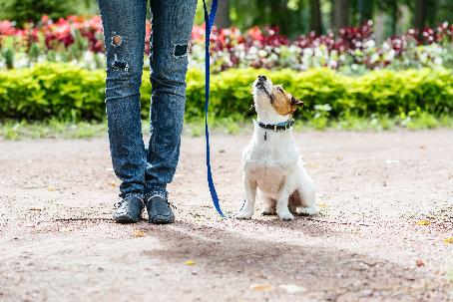
10/7 – NVA Thursday
FYI ONLY – THIS WILL BE POSTED ON YOUR BEHALF, IF OPTED INTO NVA CONTENT. NOT PARTICIPATING? EMAIL MARKETING@NVA.COM TO GET STARTED.
National Walk Your Dog Week
Post Copy:
Taking your dog on a walk can improve joint, mental, emotional, personal, and overall health for the both of you. During #NationalWalkYourDogWeek, we encourage you and your pup to go on your favorite walk to experience one of the best ways to healthily bond together. Happy #NationalWalkYourDogWeek!
Post Photo:

Slide 15
10/8 - Fun Friday
Choose 1 post from the options below:
1. Pet Patient of the Month
Post Copy:
[Name of Hospital] hopes that you are having an excellent month of October so far! Here is our September Pet Patient of the Month:
Name: [Name of Pet]
Breed: [Type of Pet]
[Why they have been named your Pet Patient of the Month]
Post Photo:
Share a photo of one of your pet patients from September (with owner approval) and share why they are your Pet Patient of the Month! This will do great with engagement!
2. National Walk Your Dog Week
Post Copy:
It’s #NationalWalkYourDogWeek! Where is your dog’s favorite place to walk?
Post Photo:
*No post photo. Intended for your clients to share their own comments and engage with the post.

Slide 16

10/9 – Saturday Caturday
FYI ONLY – THIS WILL BE POSTED ON YOUR BEHALF, IF OPTED INTO NVA CONTENT. NOT PARTICIPATING? EMAIL MARKETING@NVA.COM TO GET STARTED.
Animal Welfare Week
Post Copy:
During October’s Animal Welfare Week, we would like to give a shoutout to all of the amazing shelters that dedicate their time and energy into providing a loving space for our feline-friends while they await adoption. Learn more how you can help by visiting your local shelter today.
Post Photo:

Slide 17
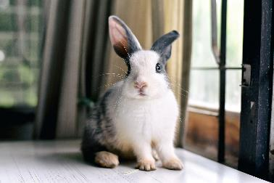
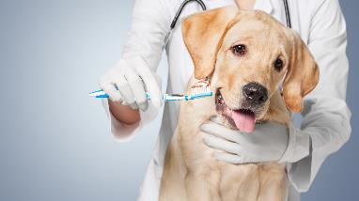
10/11 – Most Important Monday
Choose 1 post from the options below:
1. Dentistry Visit
Post Copy:
Have you brought your pet in for a dental exam recently? We encourage regular cleanings to ensure the health of your pet’s teeth, mouth, and gums, and to address any causes for complications down the line. We offer dental exams for dogs, cats, rabbits, hamsters, and more! Call us today to schedule an appointment [Hospital Phone Number].
Post Photo:
1. Online Booking Tool
Post Copy:
We heard you loud and clear! Scheduling your pet’s next appointment has never been easier. Click the link or the Book Now button above and schedule their next visit with us in no time! [Online Booking Link].
Post Photo:
Download high resolution images from GP Connect
https://www.gpconnect.nva.com/
Password woof2020

Slide 18



10/12 – Email Tuesday
AllyDVM: Edit, copy and paste the messaging below and use the pre-loaded banners to create and send a new Mass Email to your clients. Include OBT button available in your image library and add hyperlink to the Vetstoria page.
3rd Party Vendors: Use the banners and copy below with your client communication platform
Subject Line: Dentistry Visit
Dear Clients,
We recommend checking your pet’s dental health at least once a year to check for preventable diseases or underlying issues. If you haven’t been in to see us recently for a dental exam or cleaning, we encourage you to give us a call to schedule their next appointment with us!
Thank you for being an important part of our hospital and we look forward to seeing you and your pet very soon!
Schedule your appointment by calling [PRACTICE PHONE NUMBER] or BOOK ONLINE at www.HOSPITALURL.COM.
Thank you,
[PRACTICE_NAME]
***********************************************************************************************************************

Slide 19
10/12 – Vendor Email
Click the links to see the weekly client engagement from covetrus and vetsource
For Vetsource monthly marketing materials including PetMail and Social Media Posts click here
For Covetrus monthly marketing materials click here

Slide 20

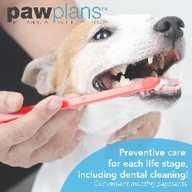
10/13 – Wellness Wednesday
Choose 1 post from the options below:
1. Home Delivery (National Pet Obesity Awareness Day)
Post Copy:
National Pet Obesity Awareness Day is an excellent time to consider changing your pet’s diet if they are beginning to become overweight. Pet obesity can have many underlying risks that may arise in the future. Talk with your veterinarian to decide which options are best for you and your pet and visit our online store for today’s top brands in diet products. You may also qualify for free shipping when you select auto-ship, as well as [new low pricing on most items throughout the store!]
Post Photo(s):
2. PAW Plans
Post Copy:
Your loved one’s dental care doesn’t have to be scary. But lack of proper dental hygiene can lead to high percentages of dogs and cats having periodontal disease. Schedule your appointment at [Hospital Name] today to find out more about proper dental care and how our PAW Plans can help mitigate future costs. Call us today at [Hospital Phone Number].
Post #3
Post Photo:
Download high resolution images from GP Connect
https://www.gpconnect.nva.com/
Password woof2020

Slide 21
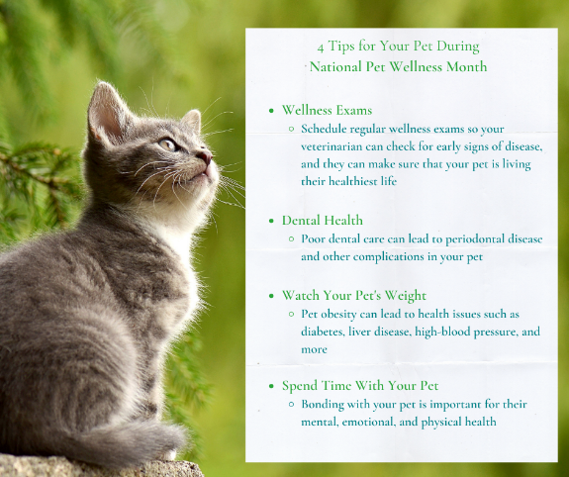
10/14 – NVA Thursday
FYI ONLY – THIS WILL BE POSTED ON YOUR BEHALF, IF OPTED INTO NVA CONTENT. NOT PARTICIPATING? EMAIL MARKETING@NVA.COM TO GET STARTED.
National Pet Wellness Month

Slide 22
10/15 - Fun Friday
Choose 1 post from the options below:
1. DVM Dentistry Tip
Post Copy:
Dr. [First Name Last Name] is here to provide a wellness tip on the importance of regular dental visits at [Name of Hospital]!
[Insert short quote or video here of DVM explaining why regular teeth cleanings and visits are important for your pet’s health]
Post Photo:
Share a photo of one of your DVM’s and ask them to share a short quote on the importance of dental visits OR take a vide of them explaining and share!
2. National Fetch Day (10/17)
Post Copy:
National Fetch Day is this Sunday! Take your pet to their favorite park and play fetch with them because they deserve it! How will you be celebrating #NationalFetchDay?
Post Photo:
*No post photo. Intended for your clients to share their own comments and engage with the post.

Slide 23
10/16 – Saturday Caturday
FYI ONLY – THIS WILL BE POSTED ON YOUR BEHALF, IF OPTED INTO NVA CONTENT. NOT PARTICIPATING? EMAIL MARKETING@NVA.COM TO GET STARTED.
National Feral Cat Day
Post Copy:
Today is National Feral Cat Day, a day to support and celebrate cats of all backgrounds! Here is everything that you need to know about feral cats in your community.
https://cattime.com/national-day/1964-national-feral-cat-day
Post Photo:
*Photo will populate from image link preview

Slide 24

10/18 – Most Important Monday
Choose 1 post from the options below:
1. Vet Tech Shoutout
Post Copy:
This week is #NationalVeterinaryTechnicianWeek! All week, we will be spotlighting a different vet tech here at [Name of Hospital] to highlight their amazing work and contributions. First up is [First Name Last Name].
[Share a short bio and give thanks to one of your amazing veterinary technicians]
Post Photo:
Share a photo of one of your veterinary technicians and share a quick bio on them. This will do great with engagement and will show deserving love to all of our vet techs!
2. Share the Love
Post Copy:
One of the best ways that you can show your support for our hospital is by referring us to one of your friends. Our Share the Love program makes it easy for you to receive $25 off your next visit with us, and $25 off your referred family member or friend on their first visit! Call us today for more information [Hospital Phone Number].
Post Photo:
Download high resolution images from GP Connect
https://www.gpconnect.nva.com/
Password woof2020

Slide 25


10/19 – Email Tuesday
AllyDVM: Edit, copy and paste the messaging below and use the pre-loaded banners to create and send a new Mass Email to your clients. Include OBT button available in your image library and add hyperlink to the Vetstoria page.
3rd Party Vendors: Use the banners and copy below with your client communication platform
Subject Line: Share the Love
Dear Client,
Thank you for entrusting us with the care of your pets. We genuinely appreciate referrals and are honored by the number of clients who recommend us to their friends and family members. Referring new clients to [PRACTICE NAME] is easy:
1. Forward this email to your friends and family. Make sure to note that they must mention your full name and the program upon their visit.
2. Your friends receive $25 off their first visit when they show this email and mention your name.
3. You receive $25 credit on your account after your friend visits our clinic. This credit can be used during your next appointment.
REFER YOUR FRIENDS TODAY AND EARN $25 PER REFERRAL!
Schedule your appointment by calling [PRACTICE PHONE NUMBER] or BOOK ONLINE at www.HOSPITALURL.COM.
With warm regards,
[PRACTICE_NAME]
***********************************************************************************************************************

Slide 26
10/19 – Vendor Email
Click the links to see the weekly client engagement from covetrus and vetsource
For Vetsource monthly marketing materials including PetMail and Social Media Posts click here
For Covetrus monthly marketing materials click here

Slide 27
10/20 – Wellness Wednesday
Choose 1 post from the options below:
1. Vet Tech Shoutout
Post Copy:
Our next vet tech that we would like to give a shoutout to during #NationalVeterinaryTechnicianWeek here at [Name of Hospital] is [First Name Last Name].
[Share a short bio and give thanks to one of your amazing veterinary technicians]
Post Photo:
Share a photo of another one of your veterinary technicians and share a quick bio on them. This will do great with engagement and will show deserving love to all of our vet techs!
2. PAW Plans
Post Copy:
No need to be spooked by scheduling regular dental cleanings. By doing so, you can help catch or prevent conditions of the gums and the bones that hold teeth in place. Take the scariness out of proper dental care and find out how we can help mitigate future costs through a specialized PAW Plan. Call us today at [Hospital Phone Number].
Post Photo:
Share a photo of one of your recent PAW Plans patients! Local photos at the location level do much better than stock photography!

Slide 28
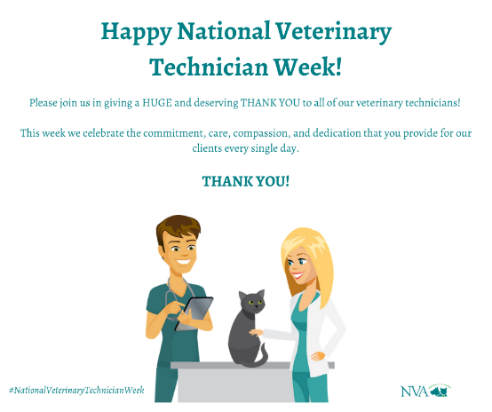
10/21 – NVA Thursday
FYI ONLY – THIS WILL BE POSTED ON YOUR BEHALF, IF OPTED INTO NVA CONTENT. NOT PARTICIPATING? EMAIL MARKETING@NVA.COM TO GET STARTED.
National Veterinary Technician Week

Slide 29
10/22 - Fun Friday
Choose 1 post from the options below:
1. Vet Tech Shoutout
Post Copy:
Meet [First Name Last Name], another one of our amazing Veterinary Technicians!
[Share a short bio and give thanks to one of your amazing veterinary technicians]
Post Photo:
Share a photo of another one of your veterinary technicians and share a quick bio on them. This will do great with engagement and will show deserving love to all of our vet techs!
2. Vet Tech Dentistry Tip
Post Copy:
Happy #NationalVeterinaryTechnicianWeek!
[Share a video of one of your Vet Tech’s explaining the importance of regular dental visits and cleanings]
Post Photo:
In honor of National Veterinary Technician Week, ask one of your vet techs to share their opinion on regular dental cleanings for pet clients.

Slide 30
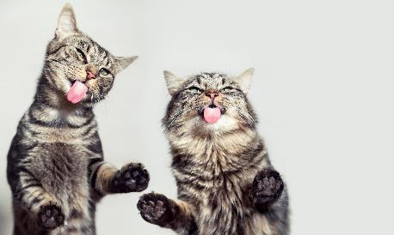
10/23 – Saturday Caturday
FYI ONLY – THIS WILL BE POSTED ON YOUR BEHALF, IF OPTED INTO NVA CONTENT. NOT PARTICIPATING? EMAIL MARKETING@NVA.COM TO GET STARTED.
National Cat Day (10/29)
Post Copy:
National Cat Day is coming up next week! Thank you to our feline-friends who provide us with companionship, love, and never a dull moment in our lives. We look forward to celebrating our feline-clients over the next week. Share a photo of your cat below!
Post Photo:

Slide 31

10/25 – Most Important Monday
Choose 1 post from the options below:
1. Dentistry Visit
Post Copy:
For this Friday’s #NationalCatDay, we are happy to announce that we are offering $[xx] off your cat’s next dental cleaning with us! Proper dental care and hygiene is important for your cat’s health. Call us today for more information. [Hospital Phone Number].
Post Photo:
*No post photo
1. We’re Hiring
Post Copy:
We’re hiring! If you’re looking for a rewarding career in pet care, please visit our website’s “Careers” tab to find out more about our open positions – or give us a call to discuss! [INSERT HOSPITAL WEBSITE AND PHONE NUMBER]
Post Photo:
Download high resolution images from GP Connect
https://www.gpconnect.nva.com/
Password woof2020

Slide 32


10/26 – Email Tuesday
AllyDVM: Edit, copy and paste the messaging below and use the pre-loaded banners to create and send a new Mass Email to your clients. Include OBT button available in your image library and add hyperlink to the Vetstoria page.
3rd Party Vendors: Use the banners and copy below with your client communication platform
Subject Line: Interested in a career in the veterinary field? We’re hiring!
Dear Clients,
Here at [ENTER HOSPITAL NAME] we’re always looking for top quality professionals that LOVE animals and their wellbeing. If you or someone you know is looking for a rewarding career in pet care, please visit our website’s “Careers” tab to find out more about our open positions – or give us a call to hear why we love our jobs so much!
Warmly,
The Doctors & Staff at [ENTER HOSPITAL NAME]
[ENTER WEBSITE ADDRESS & PHONE NUMBER]
***********************************************************************************************************************

Slide 33
10/26 – Vendor Email
Click the links to see the weekly client engagement from covetrus and vetsource
For Vetsource monthly marketing materials including PetMail and Social Media Posts click here
For Covetrus monthly marketing materials click here

Slide 34
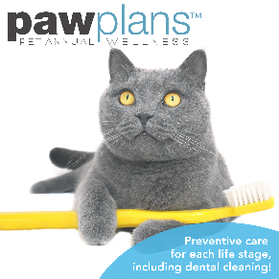
10/27 – Wellness Wednesday
Choose 1 post from the options below:
1. Home Delivery
Post Copy:
Visit our online store for the best savings on dental products for your pet! Shop now and save even more when you switch to auto-ship, [and enjoy discounted prices on most items!] Our savings will have you and your pet smiling! (Restrictions apply). [Online Pharmacy Link].
Post Photo:
Share a photo of one of your recent smiling pet patients! (With owner approval). Local photos at the location level do much better than stock photography!
2. PAW Plans
Post Copy:
The American Animal Hospital Association recommends annual cleanings start at age 1 for cats and small to medium sized dogs, and at age 2 for larger dogs. [Hospital Name] is here to help pet parents understand proper dental care and PAW Plans is here to assist with any unexpected expenses. Call [Hospital Phone Number] TODAY for more information!
Post Photo:
Download high resolution images from GP Connect
https://www.gpconnect.nva.com/
Password woof2020

Slide 35

10/28 – NVA Thursday
FYI ONLY – THIS WILL BE POSTED ON YOUR BEHALF, IF OPTED INTO NVA CONTENT. NOT PARTICIPATING? EMAIL MARKETING@NVA.COM TO GET STARTED.
Pet Halloween Costume

Slide 36


10/29 - Fun Friday
Choose 1 post from the options below:
1. National Cat Day
Post Copy:
Happy #NationalCatDay to all of our wonderful feline-clients! Thank you for being paw-some!
Post Photo:
*No post photo. Intended for your clients to share their own comments and engage with the post.
2. Happy Halloween!
Post Copy:
Happy Halloween from [Name of Hospital]! We hope that everyone has a fun & safe Halloween this weekend.
Post Photo:
Share a photo of your staff in their Halloween costumes. This will do great with engagement!

Slide 37
10/30 – Saturday Caturday
FYI ONLY – THIS WILL BE POSTED ON YOUR BEHALF, IF OPTED INTO NVA CONTENT. NOT PARTICIPATING? EMAIL MARKETING@NVA.COM TO GET STARTED.
Cat Halloween Safety Tips
Post Copy:
We hope that everyone has a fun and safe Halloween tomorrow! Here are six easy reminders to have in place for your pet’s safety during the festivities.
https://cattime.com/holidays/3012-halloween-pet-safety
Post Photo:
*Photo will populate from image link preview

Slide 38

10/31 – Halloween
Happy Halloween!
Post Copy:
Happy Halloween to all of our wonderful clients! We hope that everyone has a safe and spooky holiday!
Post Photo:

